Slide 1
Longest Common Subsequence (LCS)
Y= “ABCE”
X=“ABEC”
Longest common substring=AB
Longest Common subsequence = ABC or ABE

Slide 2
Y =
A | B | E | J
X =
A | J | B | C | E
Y, j
0 1 2 3 4
0 1 2 3 4
0
1
2
3
4
5
0 | 0 | 0 | 0 | 0
0
0
0
0
0
0
1
2
3
4
5
0 | 0 | 0 | 0 | 0
0
0
0
0
0
X, i
Cost Matrix (c)
Direction Matrix (b)
1 = Diagonal (NW) [if X_i=Y_j]
2 = Up (N)[if upper value is greater or equal to left value]
3 = Left (W) [if left value is greater than upper value]

Slide 3
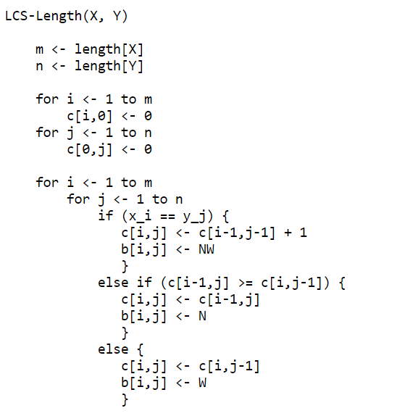

Slide 4
Y =
A | B | E | J
X =
A | J | B | C | E
Y, j
0 1A 2 B 3E 4J
0 1 2 3 4
0
1A
2J
3B
4C
5E
0 | 0 | 0 | 0 | 0
0 | 1 | 1 | 1 | 1
0 | 1 | 1 | 1 | 2
0 | 1 | 2 | 2 | 2
0 | 1 | 2 | 2 | 2
0 | 1 | 2 | 3 | 3
0
1
2
3
4
5
0 | 0 | 0 | 0 | 0
0 | NW | W | W | W
0 | N | N | N | NW
0 | N | NW | W | N
0 | N | N | N | N
0 | N | N | NW | W
X, i
Cost Matrix (c)
Direction Matrix (b)
1 = Diagonal (NW), 2 = Up (N), 3 = Left (W)

Slide 5
